Slide 1
The Gene Ontology
Barry Smith
http://ifomis.de
March 2004

Slide 2
Complexity of biological structures
About 30,000 genes in a human
Probably 100-200,000 proteins
Individual variation in most genes
100s of cell types
100,000s of disease types
1,000,000s of biochemical pathways (including disease pathways)

Slide 3
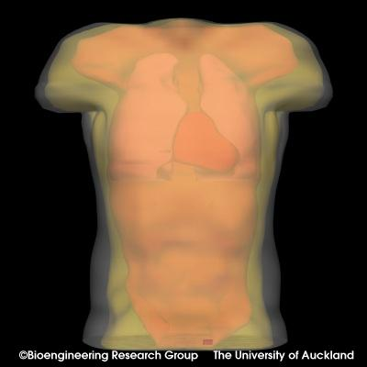

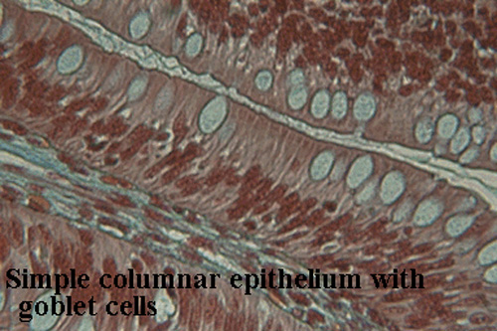
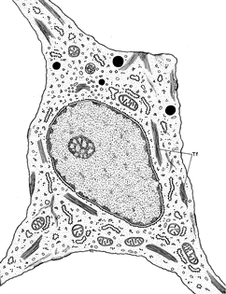
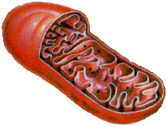
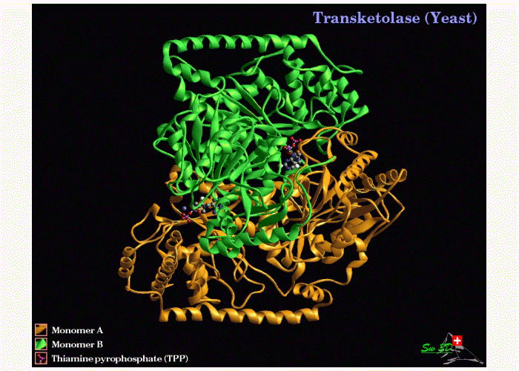
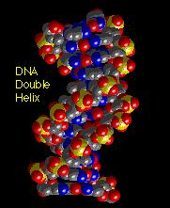
Scales of anatomy
Organism
Organ
Tissue
10⁻¹ m
Cell
Organelle
10⁻⁵ m
Protein
DNA
10⁻⁹ m

Slide 4
The Challenge
Each (clinical, pathological, genetic, proteomic, pharmacological …) information system uses its own terminology and category system
biomedical research demands the ability to navigate through all such information systems
How can we overcome the incompatibilities which become apparent when data from distinct sources is combined?

Slide 5
Answer:
“Ontology”

Slide 6
Three levels of ontology
formal (top-level) ontology dealing with categories employed in every domain:
object, event, whole, part, instance, class
2) domain ontology, applies top-level system to a particular domain
cell, gene, drug, disease, therapy
3) terminology-based ontology
large, lower-level system
Dupuytren’s disease of palm, nodules with no contracture

Slide 7
Three levels of ontology
formal (top-level) ontology dealing with categories employed in every domain:
object, event, whole, part, instance, class
2) domain ontology, applies top-level system to a particular domain
cell, gene, drug, disease, therapy
3) terminology-based ontology
large, lower-level system
Dupuytren’s disease of palm, nodules with no contracture

Slide 8
Three levels of ontology
formal (top-level) ontology dealing with categories employed in every domain:
object, event, whole, part, instance, class
2) domain ontology, applies top-level system to a particular domain
cell, gene, drug, disease, therapy
3) terminology-based ontology
large, lower-level system
Dupuytren’s disease of palm, nodules with no contracture

Slide 9
Compare:
pure mathematics (re-usable theories of structures such as order, set, function, mapping)
applied mathematics, applications of these theories = re-using the same definitions, theorems, proofs in new application domains
physical chemistry, biophysics, etc. = adding detail

Slide 10
Three levels of biomedical ontology
?????
formal (top-level) ontology =
biomedical ontology has nothing like the technology of re-usable definitions, theorems and proofs provided by pure mathematics
2) domain ontology
= e.g. GO, the Gene Ontology
3) terminology-based ontologies
= ICD-10, UMLS, SNOMED-CT, GALEN, FMA

Slide 11
Outline
Part 1: Survey of GO and its problems
Part 2: Extending GO to make a full ontology
Part 3: Conclusion

Slide 12
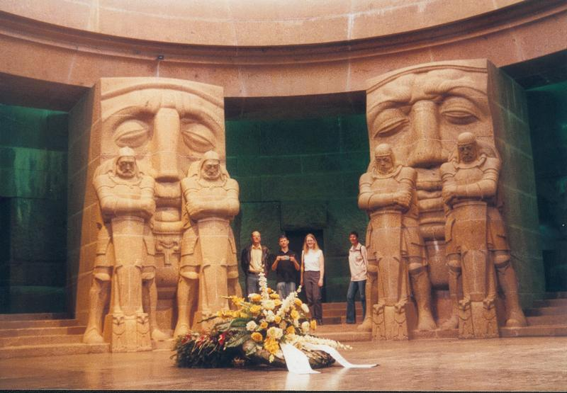
Part One
Survey of GO

Slide 13
GO is three large telephone directories
of terms used in annotating genes and gene products
‘annotating’ = indexing
GO is a ‘controlled vocabulary’ –
proximate goal: to standardize reporting of biological results
ultimate goal: to unify biology / bio-informatics

Slide 14
GO an impressive achievement
used by over 20 genome database and many other groups in academia and industry
methodology much imitated
now part of OBO (open biological ontologies) consortium

Slide 15
GO here used as an example
of the sorts of problems faced by current biomedical informatics
of the degree to which philosophy and logic are relevant to the solution of these problems

Slide 16
GO is three ontologies
cellular components
molecular functions
biological processes
December 16, 2003:
1372 component terms
7271 function terms
8069 process terms

Slide 17
Michael Ashburner:
GO’s philosophy from the beginning was ‘just in time’ - that is, we made no great attempt to ‘complete’ the ontologies …. If you try and ‘complete’ an ontology, or worse: try and ‘get it right,’ then you will fail …

Slide 18
GO built by biologists
Gene “Ontology”
Gene “Statistic”

Slide 19
When a gene is identified
three important types of questions need to be addressed:
1. Where is it located in the cell?
2. What functions does it have on the molecular level?
3. To what biological processes do these functions contribute?

Slide 20
GO’s three ontologies
molecular functions
biological processes
cellular components

Slide 21
GO confined
to what annotations can be associated with genes and gene products (proteins …)

Slide 22
The Cellular Component Ontology (counterpart of anatomy)
flagellum
chromosome
membrane
cell wall
nucleus

Slide 23
The Cellular Component Ontology (counterpart of anatomy)
“Generally, a gene product is located in or is a subcomponent of a particular cellular component.”
Cellular components are independent continuants (= they endure through time while undergoing changes of various sorts)

Slide 24
The Molecular Function Ontology
ice nucleation
protein stabilization
kinase activity
binding
The Molecular Function ontology is (roughly) an ontology of actions on the molecular level of granularity

Slide 25
Scales of anatomy
Organism
Organ
Tissue
10⁻¹ m
Cell
Organelle
10⁻⁵ m
Protein
DNA
10⁻⁹ m

Slide 26
Molecular Function
Definition:
An activity or task performed by a gene product. It often corresponds to something (such as a catalytic activity) that can be measured in vitro.
GO confuses function with functioning

Slide 27
Biological Process Ontology
Examples:
glycolysis
death
adult walking behavior
response to blue light
= occurrents on the level of granularity of organs and whole organisms

Slide 28
Biological Process
Definition:
A biological process is a biological goal that requires more than one function. Mutant phenotypes often reflect disruptions in biological processes.

Slide 29
Each of GO’s ontologies
is organized in a graph-theoretical structure involving two sorts of links or edges:
is-a (= is a subtype of )
(copulation is-a biological process)
part-of
(cell wall part-of cell)

Slide 30
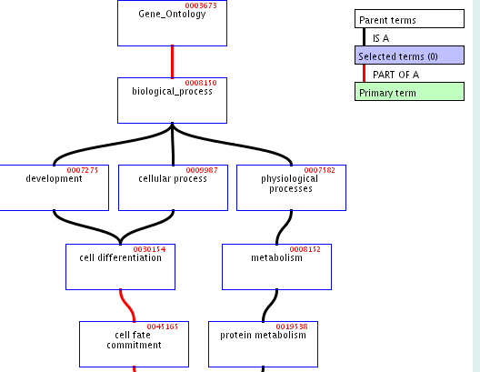

Slide 31
Primary aim
  not rigorous definition and principled classification
  but rather: to provide a practically useful framework for keeping track of the biological annotations that are applied to gene products

Slide 32
GO’s graph-theoretic architecture
designed to help human annotators to locate the designated terms for the features associated with specific genes

Slide 33
GO is a
‘controlled vocabulary’
designed to ensure that the same terms are used by different research groups with the same meanings

Slide 34
Principle of Univocity
terms should have the same meanings (and thus point to the same referents) on every occasion of use

Slide 35
Principle of Compositionality
The meanings of compound terms should be determined
1. by the meanings of component terms
together with
2. the rules governing syntax

Slide 36
The story of ‘/’

Slide 37
/
GO:0008608 microtubule/kinetochore interaction
=df Physical interaction between microtubules and chromatin via proteins making up the kinetochore complex

Slide 38
/
GO:0001539 ciliary/flagellar motility
=df Locomotion due to movement of cilia or flagella.

Slide 39
/
GO:0045798 negative regulation of chromatin assembly/disassembly
=df Any process that stops, prevents or reduces the rate of chromatin assembly and/or disassembly

Slide 40
/
GO:0000082 G1/S transition of mitotic cell cycle
=df Progression from G1 phase to S phase of the standard mitotic cell cycle.

Slide 41
/
GO:0001559 interpretation of nuclear/cytoplasmic to regulate cell growth
=df The process where the size of the nucleus with respect to its cytoplasm signals the cell to grow or stop growing.

Slide 42
/
GO:0015539 hexuronate (glucuronate/galacturonate) porter activity
=df Catalysis of the reaction: hexuronate(out) + cation(out) = hexuronate(in) + cation(in)

Slide 43
comma
lactose, galactose: hydrogen symporter activity
male courtship behavior (sensu Insecta), wing vibration

Slide 44
Principle of Positivity
Class names should be positive. Logical complements of classes are not themselves classes.
(Terms such as ‘non-mammal’ or ‘non-membrane’ or ‘invertebrate’ or do not designate natural kinds.)

Slide 45
Problems with negation
GO has no way to express ‘not’ and no way to express ‘is localized at’)
Holliday junction helicase complex
is-a
unlocalized

Slide 46
GO:0008372 cellular component unknown cellular component unknown is-a cellular component

Slide 47
Principle of Objectivity
which classes exist is not a function of our biological knowledge.
(Terms such as ‘unclassified’ or ‘unknown ligand’ or ‘not otherwise classified as peptides’ do not designate biological natural kinds, and nor do they designate differentia of biological natural kinds)

Slide 48
Rabbit and copulation both designate natural kinds, but terms such as
rabbit and copulation
rabbit or copulation
do not
Cf. Lewis-Armstrong sparse theory of universals
Veterinary proprietary drug and/or biological
has 2532 children in SNOMED-CT

Slide 49
Principle of Sparseness
Which biological classes exist is not a matter of logic. (Biological combination is not reflected in a Boolean algebra)

Slide 50
oxidoreductase activity,
acting on paired donors,
with incorporation or reduction of molecular oxygen, 2-oxoglutarate as one donor,
and incorporation of one atom each of oxygen into both donors

Slide 51
Is biological classification Linnaean?

Slide 52
1. Principle of Single Inheritance
no class in a classificatory hierarchy should have more than one parent on the immediate higher level
no diamonds:

Slide 53
2. Principle of Taxonomic Levels
the terms in a classificatory hierarchy should be divided into predetermined levels (analogous to the levels of kingdom, phylum, class, order, etc., in traditional biology).
‘depth’ in GO’s hierarchies not determinate because of multiple inheritance

Slide 54
Principle of Taxonomic Levels

Slide 55
Principle of Exhaustiveness
the classes on any given level should exhaust the domain of the classificatory hierarchy.

Slide 56
Single Inheritance + Exhaustiveness = JEPD
Exhaustiveness often difficult to satisfy in the realm of biological phenomena; but its acceptance as an ideal is presupposed as a goal by every scientist.
Single inheritance accepted in all traditional (species-genus) classifications, now under threat because multiple inheritances is a computationally useful device (allows one to avoid certain kinds of combinatoric explosion).

Slide 57
Problems with multiple inheritance
B C
is-a₁ is-a₂
A
‘is-a’ no longer univocal

Slide 58
Problems with multiple inheritance
B C
is-a₁ is-a₂
A E
D
‘sibling’ is no longer determinate

Slide 59
‘is-a’ is pressed into service to mean a variety of different things
the resulting ambiguities make the rules for correct coding difficult to communicate to human curators
they also serve as obstacles to integration with neighboring ontologies

Slide 60
is-a
GO’s definition:
A is-a B =def every instance of A is an instance of B
= standard definition of computer science
(confusion of ‘class’ with ‘set’, failure to take time seriously)
adult is-a child

Slide 61
is-a
(α) there are times at which instances of A exist, and at all such times these instances are also instances of B
animal-owned-by-the-emperor is-a animal-weighing-less-than-200-kgs

Slide 62
is-a
(β) A and B are natural kinds, and there are times at which instances of A exist, and at all such times these instances are also instances of B
albino antelope is-a antelope susceptible to rabies

Slide 63
is-a
(γ) A and B are natural kinds, and there are times at which instances of A exist, and at all such times these instances are necessarily (of their very nature) also instances of B
1. eukaryotic cell is-a cell
2. terminal glycosylation is-a protein glycosylation

Slide 64
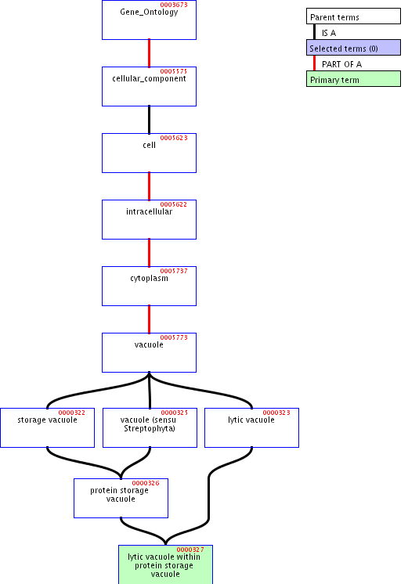

Slide 65
storage vacuole is-a vacuole
a storage vacuole is not a special kind of vacuole
a box used for storage is not a special kind of box

Slide 67
‘within’
lytic vacuole within a protein storage vacuole
lytic vacuole within a protein storage vacuole is-a protein storage vacuole
time-out within a baseball game is-a baseball game
embryo within a uterus is-a uterus

Slide 68
Problems with Location
is-located-at / is-located-in and similar relations need to be expressed in GO via some combination of ‘is-a’ and ‘part-of’
… is-a unlocalized
… is-a site of …
… within …
… in …

Slide 69
Problems with location
extrinsic to membrane part-of membrane
extrinsic to membrane
Definition: Loosely bound, by ionic or covalent forces, to one or other surface of the cell membrane, but not integrated into the hydrophobic region.

Slide 70
part-of
not a mereological relation between individuals
but a relation between classes

Slide 71
Problems with GO’s part-of
GO’s old definition of part-of:
A part-of B =def A can be part of B
asserted to be transitive

Slide 72
Three meanings of ‘part-of ’
‘part-of’ = ‘can be part of’ (flagellum part-of cell)
‘part-of’ = ‘is sometimes part of’ (replication fork part-of the nucleoplasm)
‘part-of’ = ‘is included as a sublist in’

Slide 73
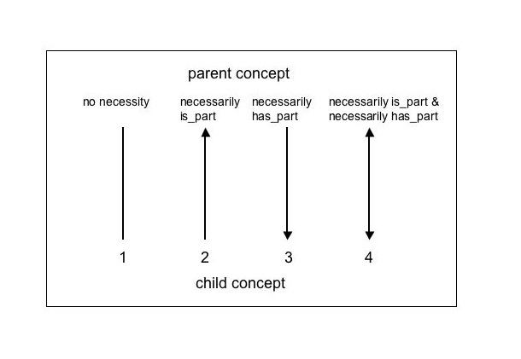
New definition of part-of
There are four basic levels of restriction for a part_of relationship:

Slide 74
New definition of part-of
The first type has no restrictions. That is, no inferences can be made from the relationship between parent and child other than that the parent may or may not have the child as a part, and the the child may or may not be a part of the parent.
The second type, 'necessarily is_part', means that wherever the child exists, it is as part of the parent: 'replication fork' is part_of 'chromosome', so whenever 'replication fork' occurs, it is as part_of 'chromosome', but 'chromosome' does not necessarily have part 'replication fork'.

Slide 75
Type three, 'necessarily is_part', is the exact inverse of type two …
The final type is a combination of both three and four, 'has_part' and 'is_part'.

Slide 76
part-of = is necessarily part of
The part_of relationship used in GO is usually type two, 'necessarily is_part'. Note that part_of types 1 and 3 are not used in GO

Slide 77
Official definition
term: part_of
definition: Used for representing partonomies.

Slide 78
Official definition
term: derived_from
definition: Any kind of temporal relationship,
such as derived_from, translated_from

Slide 79
Problems with GO’s definitions
GO:0003673: cell fate commitment
Definition: The commitment of cells to specific cell fates and their capacity to differentiate into particular kinds of cells.
x is a cell fate commitment =def
x is a cell fate commitment and p

Slide 80
rules for definitions
intelligibility: the terms used in a definition should be simpler (more intelligible) than the term to be defined
definitions: do not confuse definitions with the communication of new knowledge

Slide 81
Principle of Substitutability
in all extensional contexts a defined term should be substitutable by its definition in such a way that the result is both grammatically correct and has the same truth-value as the sentence with which we begin

Slide 82
toxin transporter activity
Definition: Enables the directed movement of a toxin into, out of, within or between cells. A toxin is a poisonous compound (typically a protein) that is produced by cells or organisms and that can cause disease when introduced into the body or tissues of an organism.

Slide 83
fimbrium-specific chaperone activity
Definition: Assists in the correct assembly of fimbria, extracellular organelles that are used to attach a bacterial cell to a surface, but is not a component of the fimbrium when performing its normal biological function.

Slide 84
Genbank
a gene is a DNA region of biological interest with a name and that carries a genetic trait or phenotype

Slide 85
GO’s three ontologies are separate
molecular functions
biological processes
No links or edges defined between them
cellular components

Slide 86
Occurrents
Both molecular function and biological process terms refer to occurrents
= entities which do not endure through time but rather unfold themselves in successive temporal phases.
Occurrents can be segmented into parts along the temporal dimension.
Continuants exist in toto in every instant at which they exist at all.

Slide 87
Three granularities:
Molecular (for ‘functions’)
Cellular (for components)
Whole organism (for processes)

Slide 88
GO does not include molecules or organisms within any of its three ontologies
The only continuant entities within the scope of GO are cellular components (including cells themselves)

Slide 89
Are the relations between functions and processes a matter of granularity?
Molecular activities are the building blocks of biological processes ?
But they cannot be represented in GO as parts of biological processes

Slide 90
GO does not recognize parthood relations between entities on its three distinct levels of granularity
Compare:
this wheel is part of the car
this molecule is part of the car

Slide 91
Functions
‘The functions of a gene product are the jobs it does or the “abilities” it has’

Slide 92
Functions
chaperone activity motor activity catalytic activity signal transducer activity structural molecule activity transporter activity binding antioxidant activity | chaperone regulator activity enzyme regulator activity transcription regulator activity triplet codon-amino acid adaptor activity translation regulator activity nutrient reservoir activity

Slide 93
Appending function terms with ‘activity’
In 2003 all GO molecular function terms were appended … with the word 'activity'.
structural constituent of bone
structural constituent of cuticle
structural constituent of cytoskeleton
structural constituent of epidermis
structural constituent of eye lens
structural constituent of muscle
structural constituent of nuclear pore
structural constituent of ribosome
structural constituent of tooth enamel

Slide 94
terms appended with ‘activity’ …
because GO molecular functions are what philosophers would call 'occurrents', meaning events, processes or activities, rather than 'continuants' which are entities e.g. organisms, cells, or chromosomes. The word activity helps distinguish between the protein and the activity of that protein, for example, nuclease and nuclease activity.
In fact, a molecular 'function' is distinct from a molecular 'activity'. A function is the potential to perform an activity, whereas an activity is the realisation, the occurrence of that function; so in fact, 'molecular function' might more properly be renamed 'molecular activity'. However, for reasons of consistency and stability, the string 'molecular function' endures.

Slide 96
Part Two
Extending GO to make a full ontology

Slide 97
toxin transporter activity
Definition: Enables the directed movement of a toxin into, out of, within or between cells. A toxin is a poisonous compound (typically a protein) that is produced by cells or organisms and that can cause disease when introduced into the body or tissues of an organism.

Slide 98
Some formal ontology
Components are independent continuants
Functions are dependent continuants
(the function of an object exists continuously in time, just like the object which has the function;
and it exists even when it is not being exercised)
Processes are (dependent) occurrents

Slide 99
GO must be linked with other, neighboring ontologies
GO has: adult walking behavior but not adult
GO has: eye pigmentation but not eye
GO has: response to blue light but not light (or blue)
94% of words used in GO terms are not GO terms

Slide 100
Principle of Dependence
If an ontology recognizes a dependent entity then it (or a linked ontology) should recognize also the relevant class of bearers

Slide 101
Linking to external ontologies
can also help to link together GO’s own three separate parts

Slide 102
GO’s three ontologies
biological processes
molecular functions
← dependent →
cellular components
← independent

Slide 103
GO’s three ontologies
cellular
processes
organism-level
biological processes
molecular functions
cellular components

Slide 104
molecular functions
cellular
processes
organism-level
biological processes
molecule
complexes
cellular components
organisms
‘part-of’; ‘is dependent on’

Slide 105
part-of:
is dependent on:

Slide 106
molecular functions
cellular
processes
organism-level
biological processes
molecule
complexes
cellular components
organisms

Slide 107
molecular processes
cellular
processes
organism-level
biological processes
molecular functions
cellular
functions
organism-level
biological functions
molecule
complexes
cellular components
organisms

Slide 108
molecular processes
cellular
processes
organism-level
biological processes
functionings
functionings
functionings
molecular functions
cellular
functions
organism-level
biological functions
molecule
complexes
cellular components
organisms

Slide 109
Human beings know what ‘walking’ means
Human beings know that adults are older than embryos
GO needs to be linked to ontology of development
and in general to resources for reasoning about time and change

Slide 110
but such linkages are possible
only if GO itself has a coherent formal architecture

Slide 112
Is this all just philosophy ?

Slide 113
Human consequences of inconsistent and/or indeterminate use of operators such as ‘/ ’
29% of GO’s contain one or more problematic syntactic operators
but these terms are used in only 14% of annotations
Hypothesis: reflects the fact that poorly defined operators are not well understood by annotators, who thus avoid the corresponding terms

Slide 114
Computational consequences of inconsistent and/or indeterminate use of operators
The information captured by GO through its use of problematic syntactic operators is not available for purposes of information retrieval

Slide 115
Problems caused by GO’s formal incoherence
1. Coding errors → constant updating
2. Need for expert knowledge (which computers do not have access to)
3. Obstacles to ontology integration

Slide 116
Problems caused by GO’s formal incoherence
4. It is unclear what kinds of reasoning are permissible on the basis of GO’s hierarchies.
5. The rationale of GO’s subclassifications is unclear.
6. No procedures are offered by which GO can be validated.

Slide 117
Quality assurance and ontology maintenance must be automated
As GO increases in size and scope it will “be increasingly difficult to maintain the semantic consistency we desire without software tools that perform consistency checks and controlled updates”

Slide 118
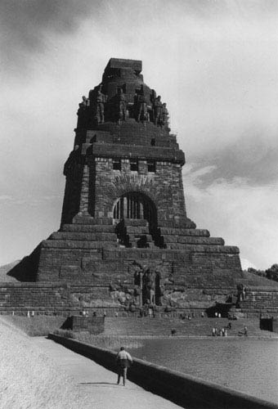

The End

